Slide 1

Filmweb Movie Analysis
Grzegorz Bortnik 18.06.2025

Slide 2

Project Overview
Analyzing data from the top 500 movies listed on Filmweb, a leading Polish film platform. The dataset was collected via web scraping and serves as the basis for uncovering trends and insights in the film rankings.

Slide 3

Objectives
Identify prevailing trends shaping the film industry through audience ratings and reviews
Examine which genres consistently receive the highest acclaim from viewers
Contrast the opinions and preferences of general users with those of professional critics
Highlight the most popular films and filmmakers that resonate strongly with the audience

Slide 4

Methodology
The project was built using Python, with the dataset created by web scraping the top 500 movies from Filmweb. The scraped data was exported to a CSV file for analysis. For data exploration and visualization, libraries such as Pandas, Matplotlib, Seaborn, and Plotly Express were used. Development took place in Visual Studio Code and Jupyter Notebook, providing an interactive and flexible environment.

Slide 5

Key Visualizations

Slide 6
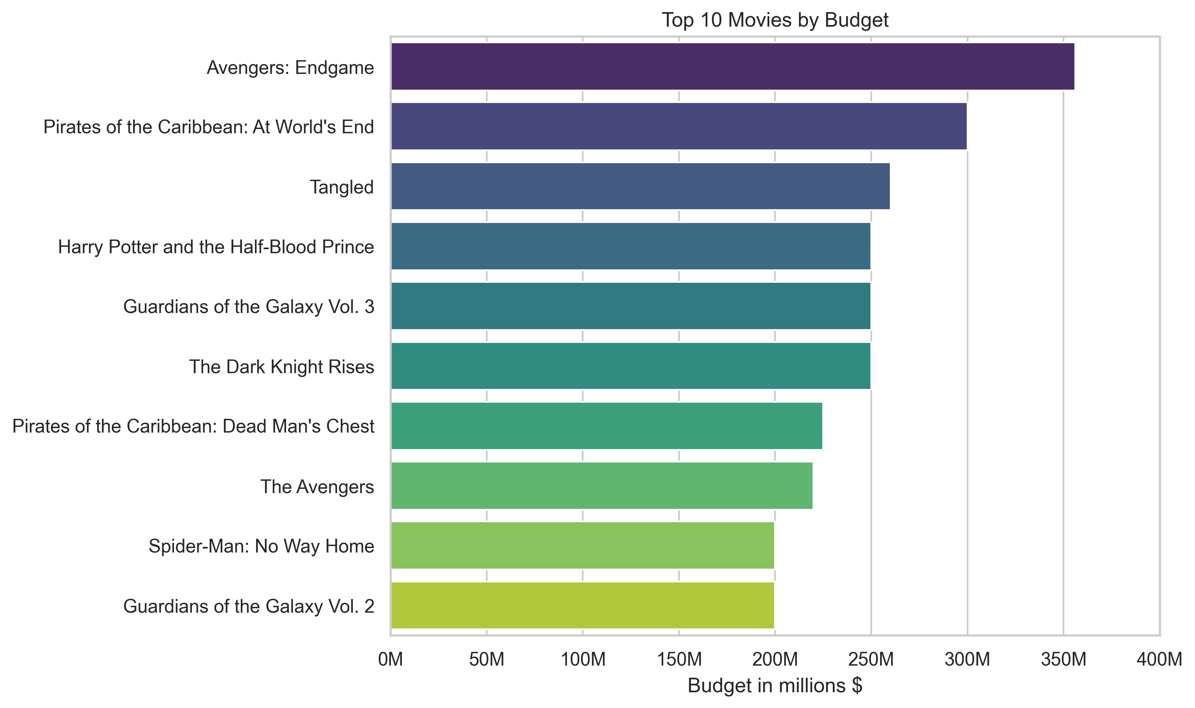
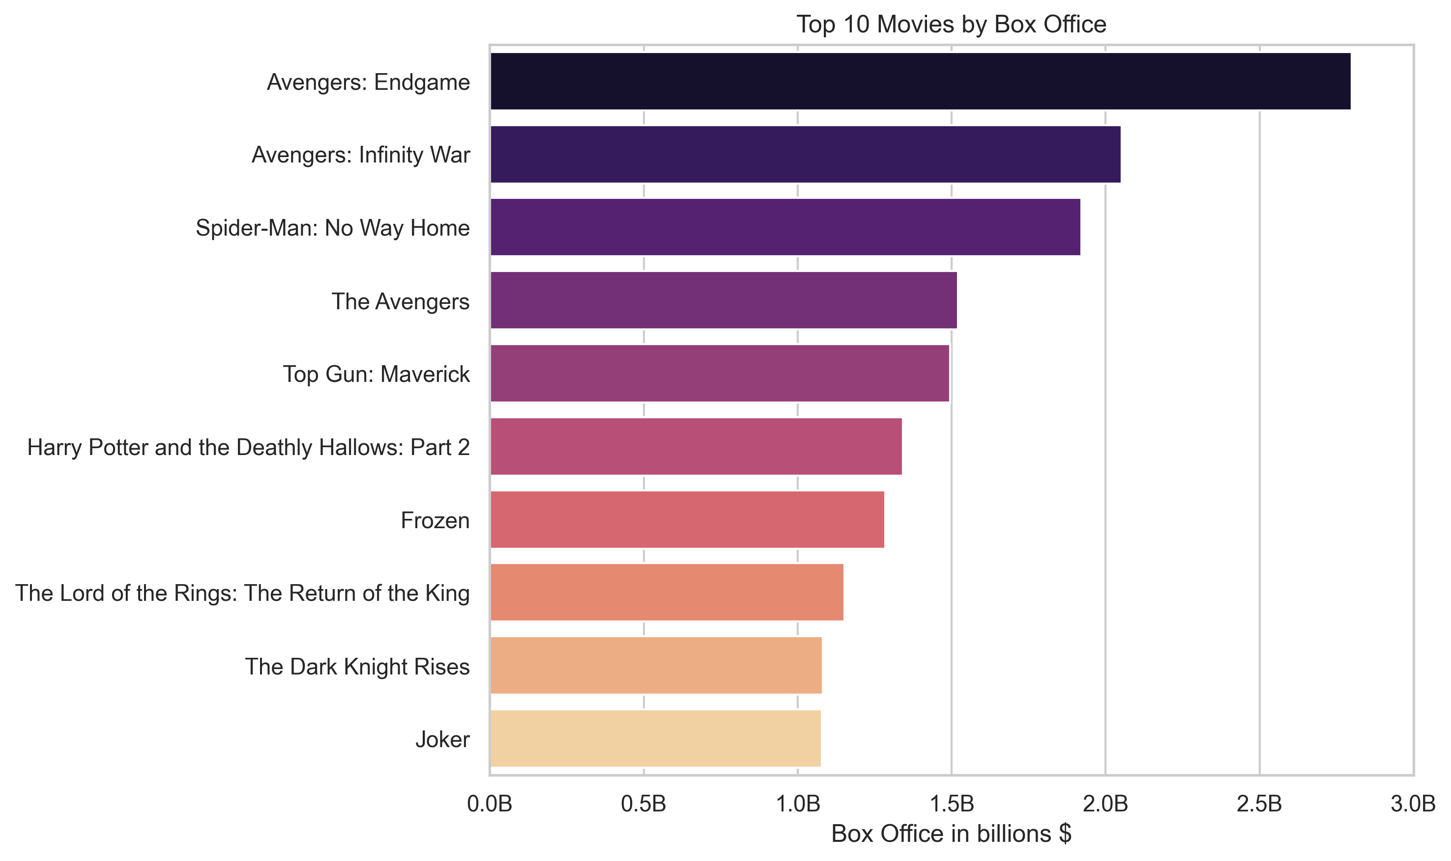
Leading Titles by Budget, Revenue & Rating

Slide 7
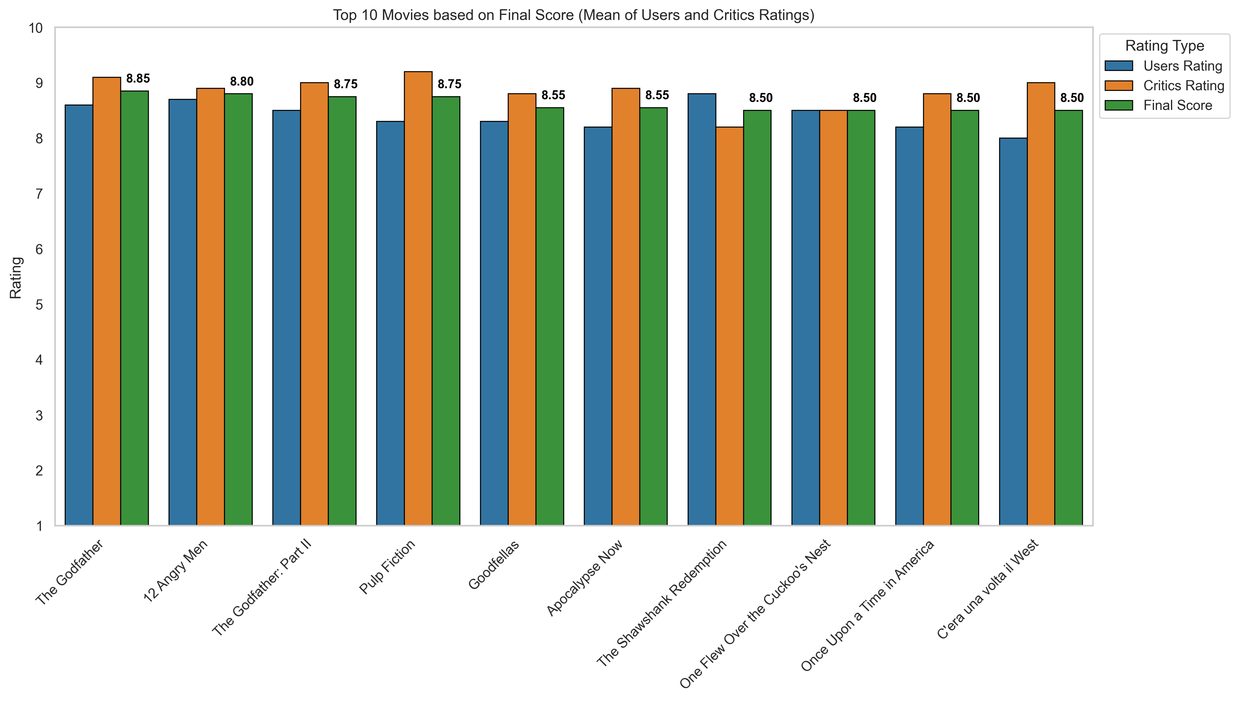
Leading Titles by Budget, Revenue & Rating

Slide 8

Leading Titles by Budget, Revenue & Rating Insights & Implications
The Marvel Cinematic Universe dominates the Box Office rankings, occupying the top four positions. Avengers: Endgame leads both in terms of budget and box office revenue.
The highest-grossing and most expensive films tend to be recent releases, frequently belonging to superhero franchises, fantasy genres, or animated films. In contrast, the best-rated movies are often classic films produced throughout the 20th century.
The Godfather stands out as the highest-rated film when considering the combined scores from both users and critics on Filmweb.

Slide 9
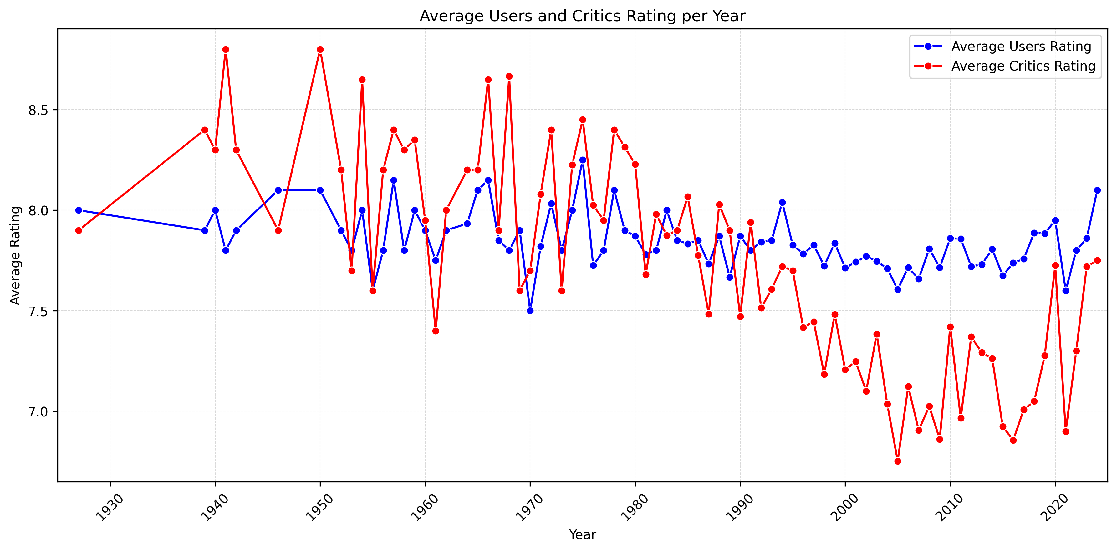
The Evolution of Top Movies Through the Decades

Slide 10
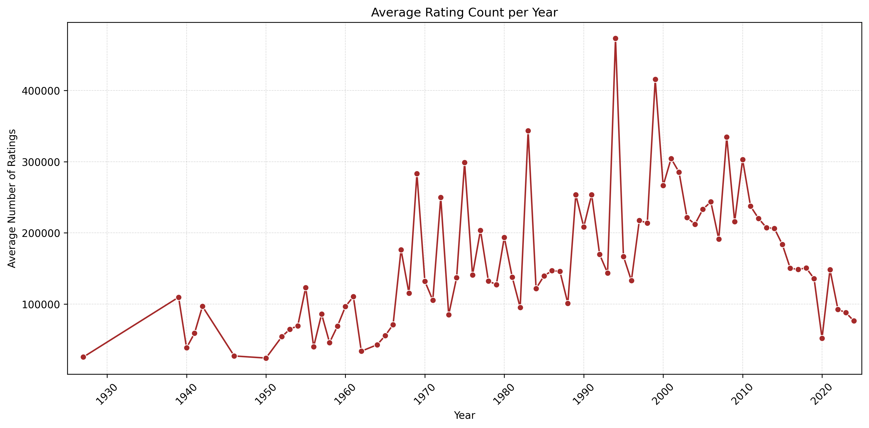
The Evolution of Top Movies Through the Decades

Slide 11
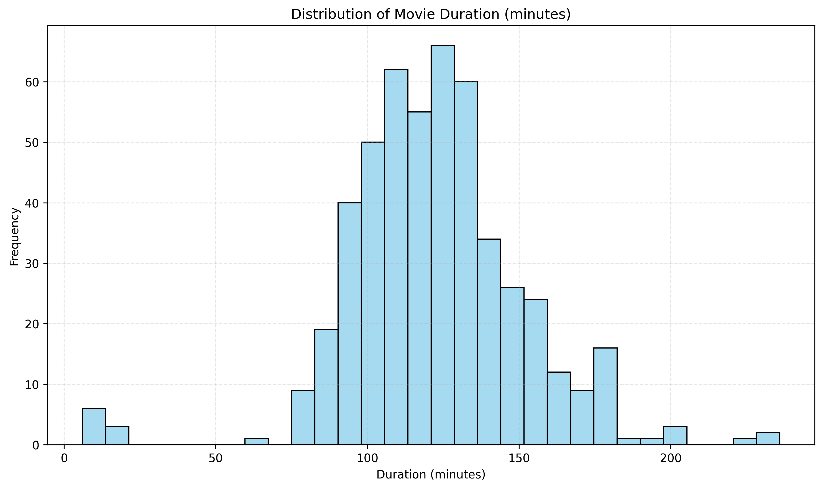
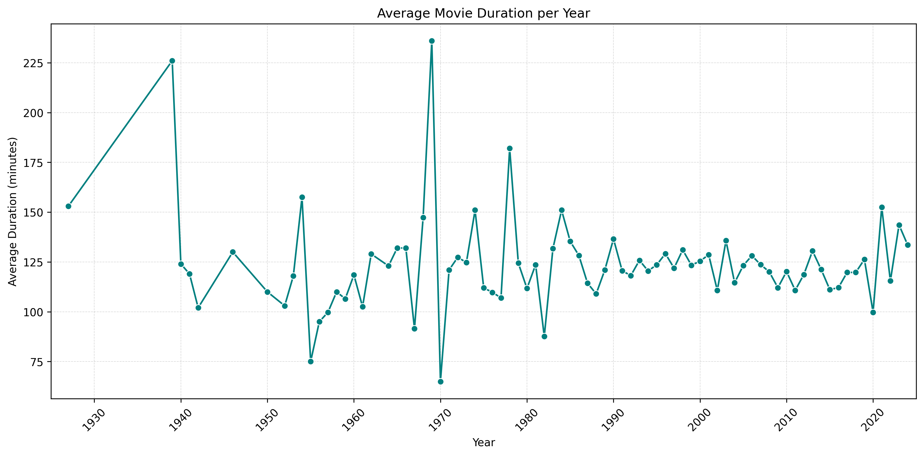
The Evolution of Top Movies Through the Decades

Slide 12
The Evolution of Top Movies Through the Decades Insights & Implications
User ratings remain relatively stable regardless of a film’s release year, suggesting consistent audience appreciation across eras. In contrast, critic ratings show a noticeable decline for newer films, which may indicate a preference among critics for older, perhaps more classic cinema.
Popularity, measured by the number of user ratings, begins to rise significantly for films from the 1970s onward, peaking for movies released in the 1990s and early 2000s. More recent films have yet to accumulate as many ratings, likely due to limited exposure time.
Regarding film length, there is no substantial change over the decades, aside from a few outliers. The most common duration for top-ranked films hovers around two hours, though the ranking also includes both longer epics and very short productions. Notably, the shortest film in the ranking is “Sztuka Spadania”, lasting only six minutes.

Slide 13
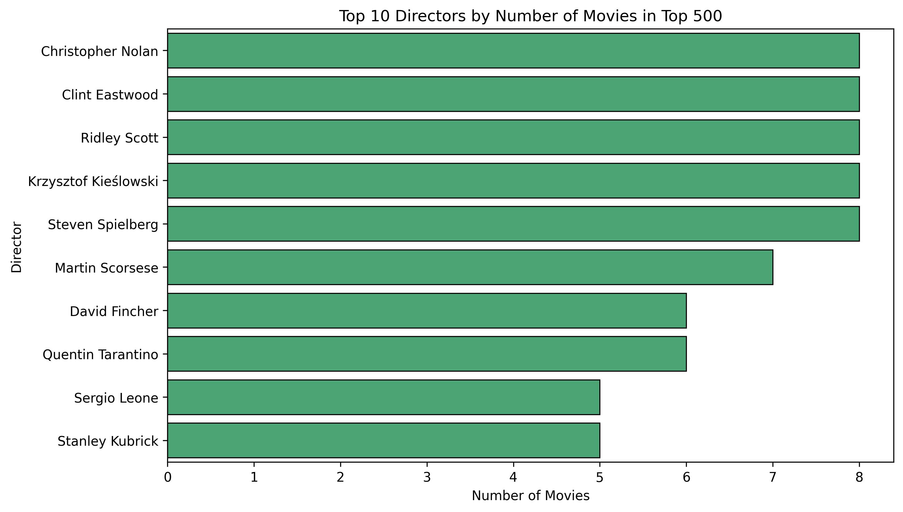
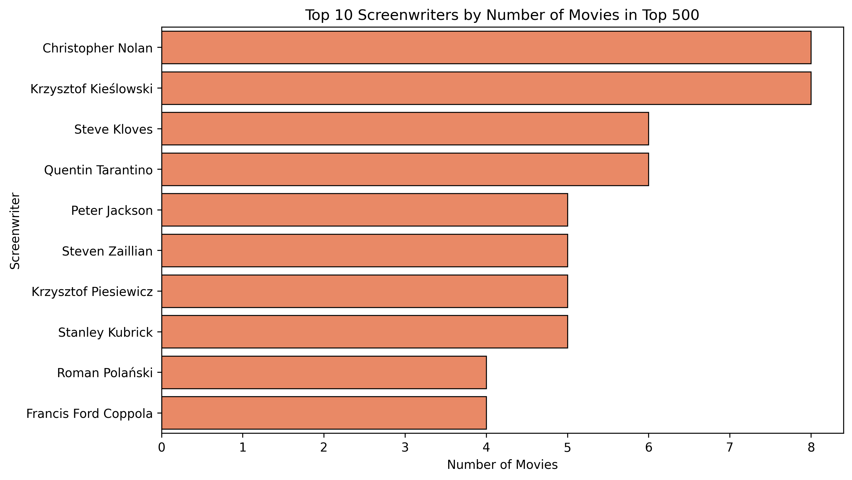
Spotlight on Creators: Top Directors & Screenwriters

Slide 14
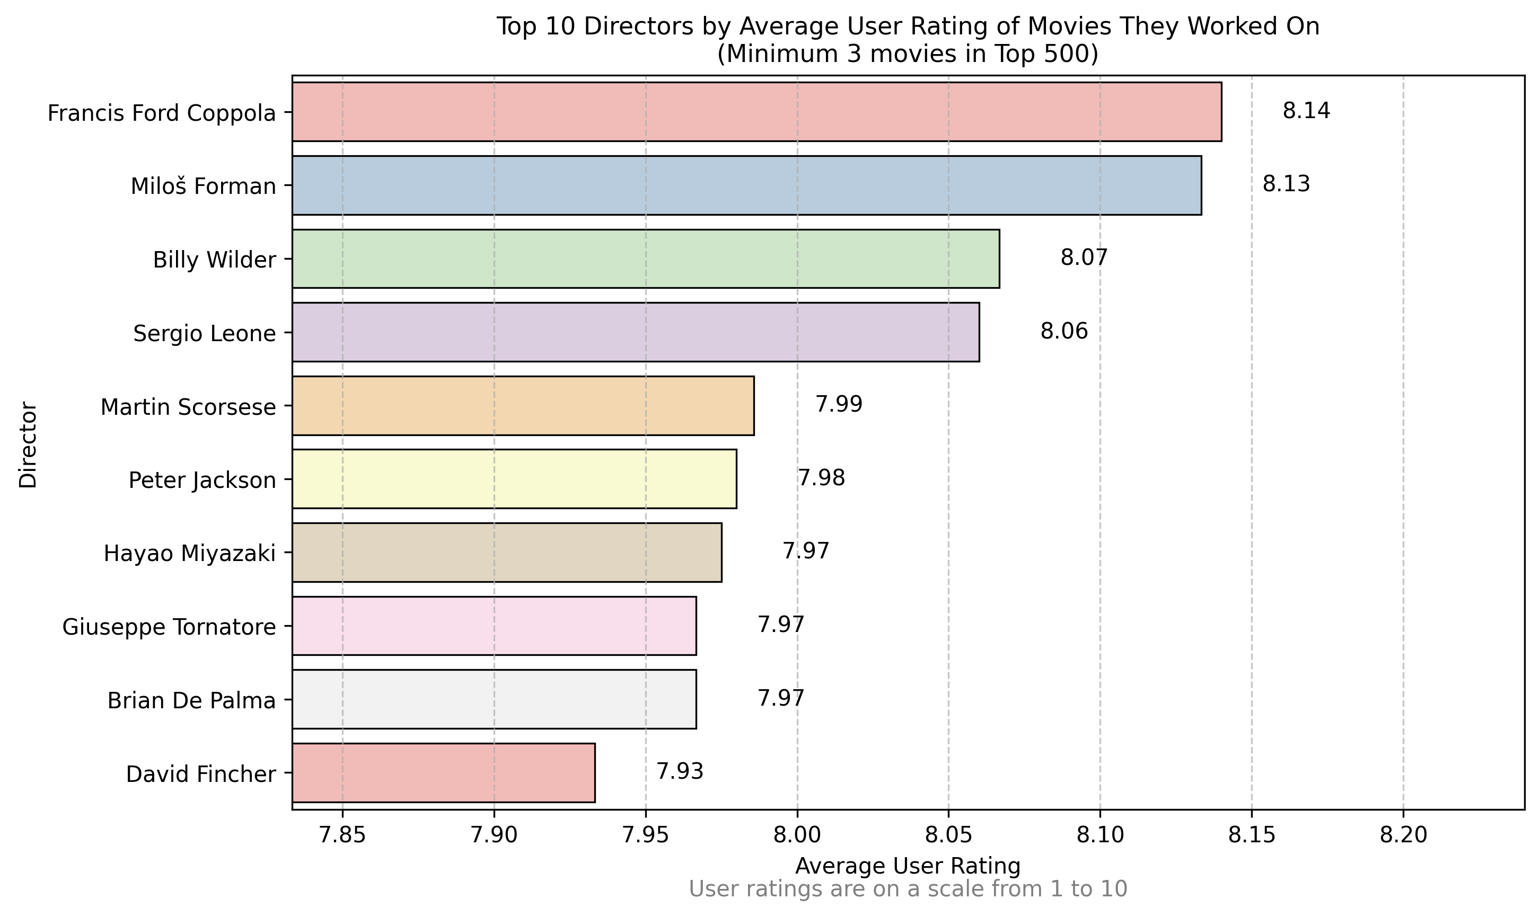
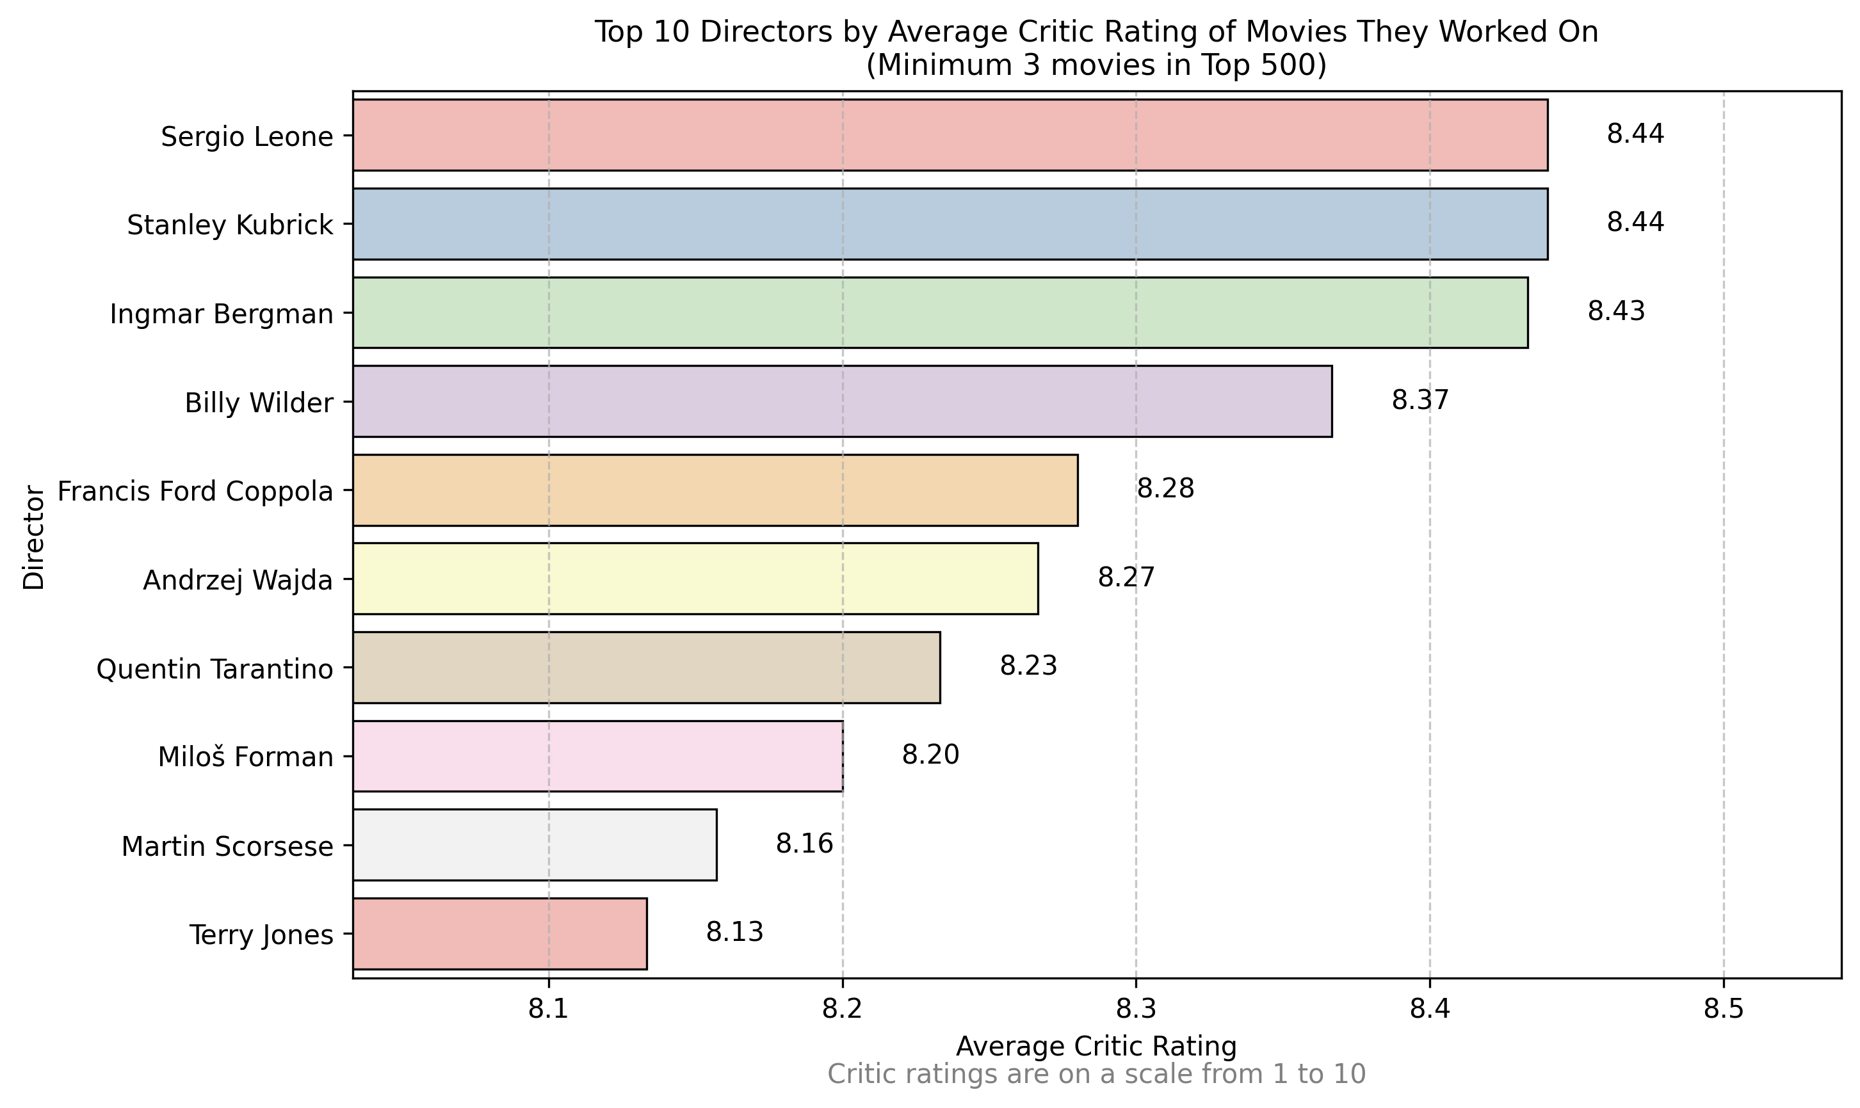
Spotlight on Creators: Top Directors & Screenwriters

Slide 15
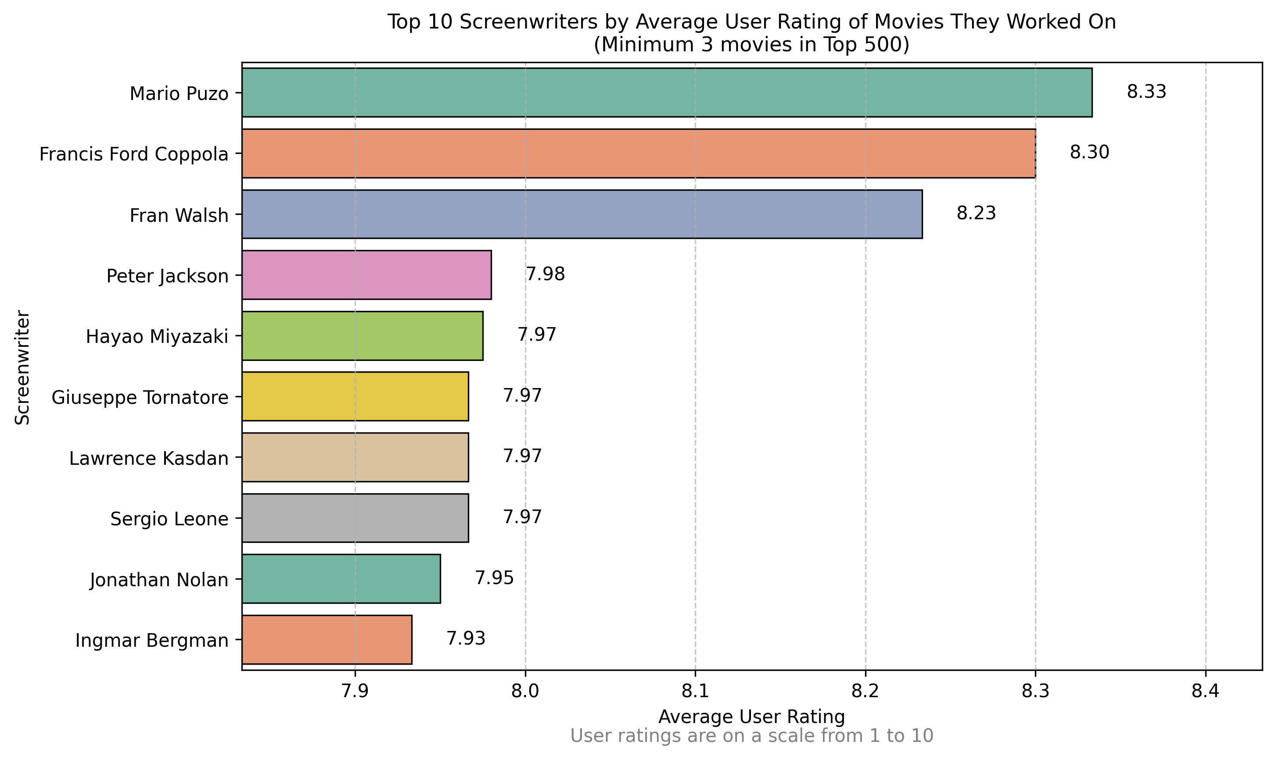
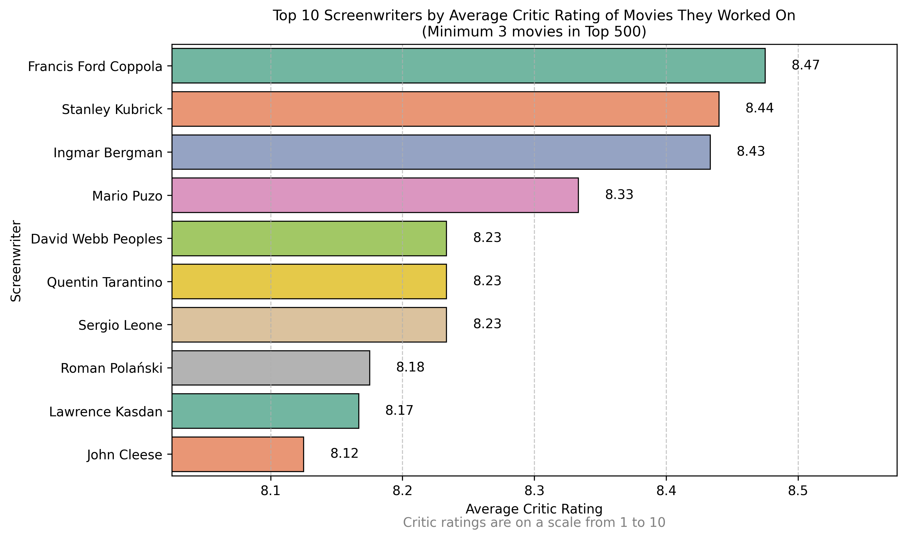
Spotlight on Creators: Top Directors & Screenwriters

Slide 16
Spotlight on Creators: Top Directors & Screenwriters Insights & Implications
Among the top 500 films, Christopher Nolan and Krzysztof Kieślowski stand out as the most celebrated creators by the Polish audience, each having an impressive eight films featured in the ranking—often serving as both director and screenwriter.
Other frequently recognized names among the highest-rated films by both users and critics include Francis Ford Coppola (notably for The Godfather), Sergio Leone (renowned for his Westerns), Hayao Miyazaki (founder of Japan’s Studio Ghibli), and Stanley Kubrick, who is especially acclaimed by critics.
In addition to Kieślowski, prominent Polish filmmakers such as Andrzej Wajda and Roman Polanski also appear among the top-ranked creators, highlighting the significant influence of Polish cinema in the top 500.

Slide 17
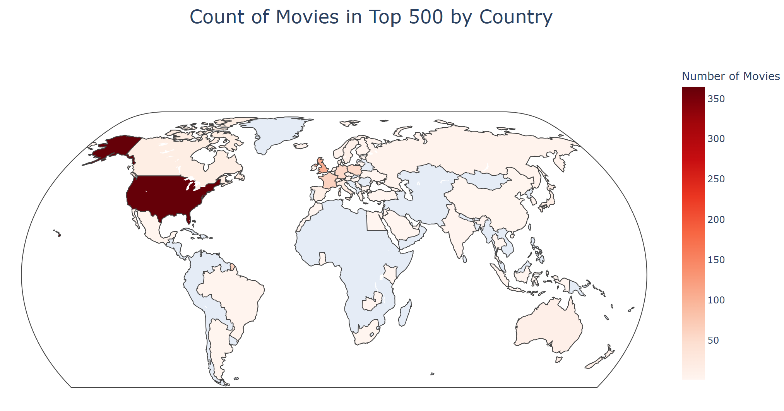
Global Footprint of Top Movies
Interactive version of this visualization can be found here

Slide 18
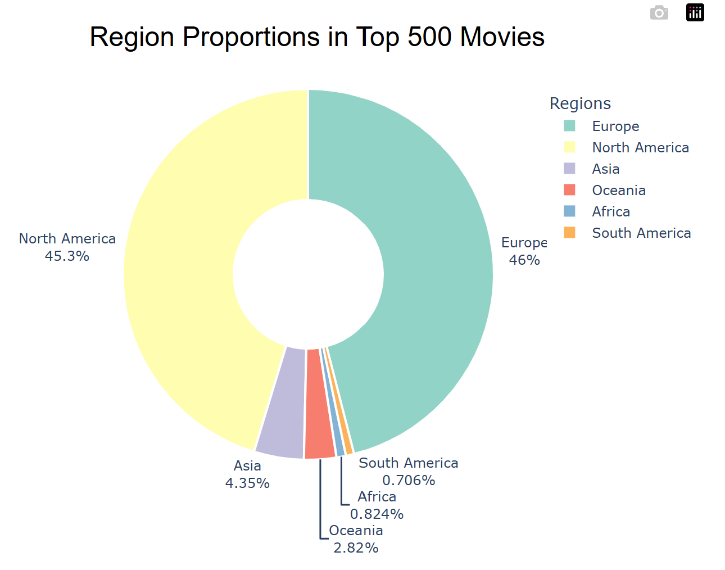
Global Footprint of Top Movies
Interactive version of this visualization can be found here

Slide 19
Global Footprint of Top Movies Insights & Implications
The United States stands out as the leading country in the production of top 500 movies, underscoring Hollywood’s dominant position and global influence in the film industry.
When looking at regions, North America and Europe overwhelmingly contribute to the production of these films, while all other regions combined account for less than 9% of the total production share—highlighting a significant geographic imbalance in the top 500 ranking.

Slide 20
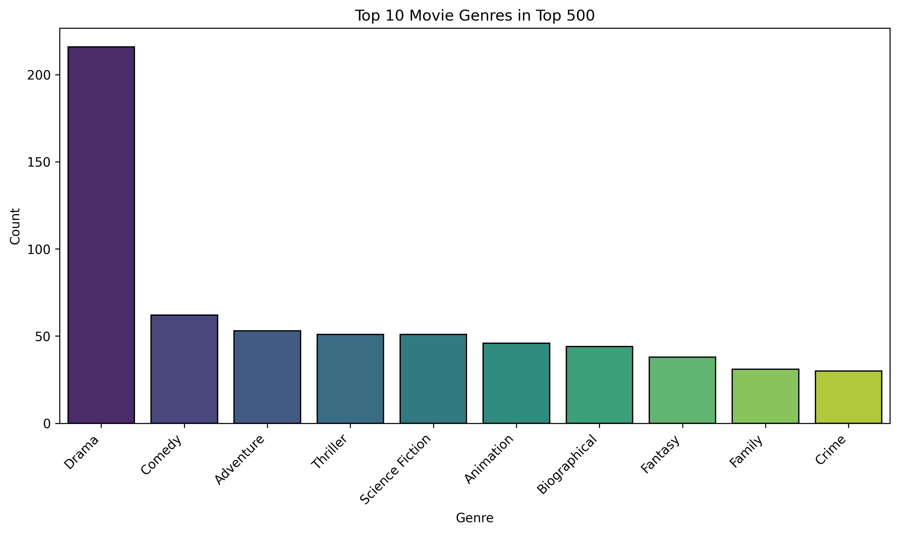
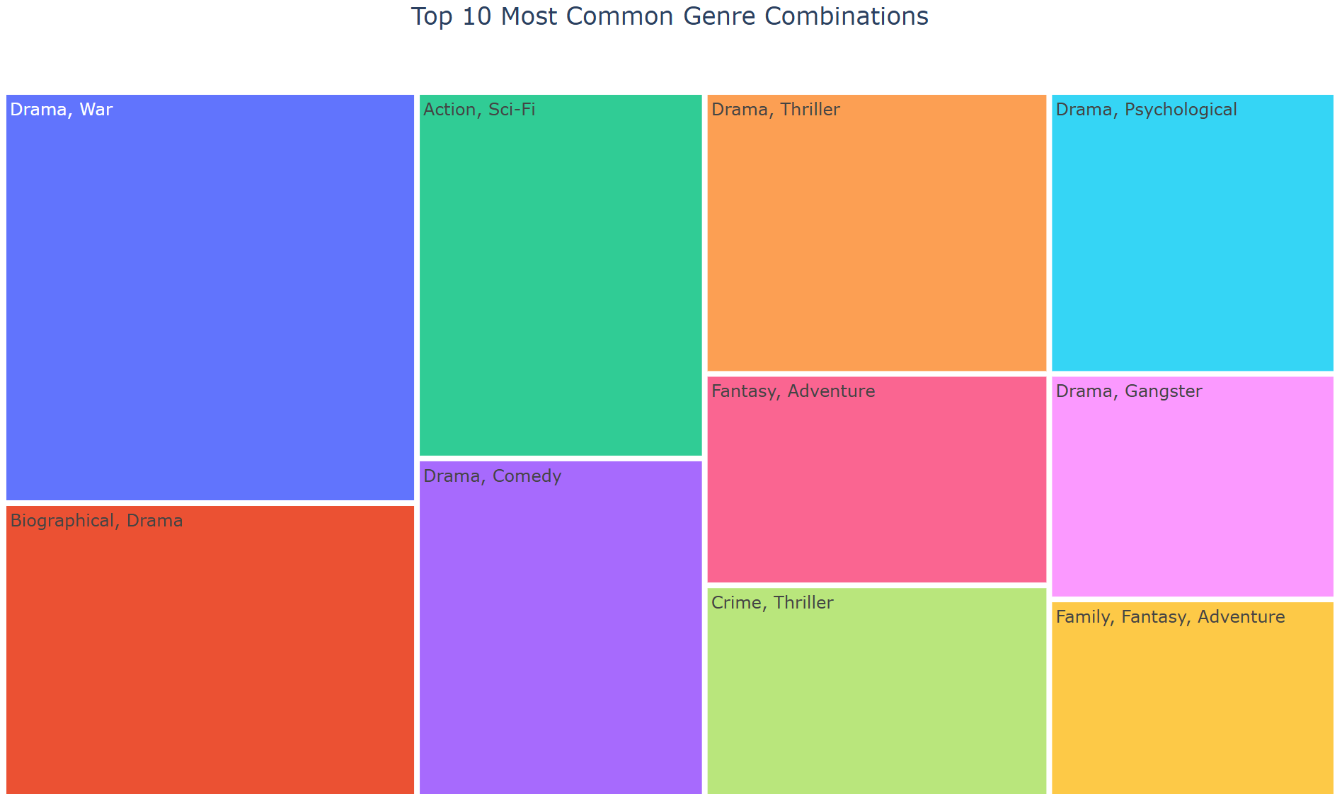
Exploring Genres in the Top 500 Movies
Interactive version of this visualization can be found here

Slide 21
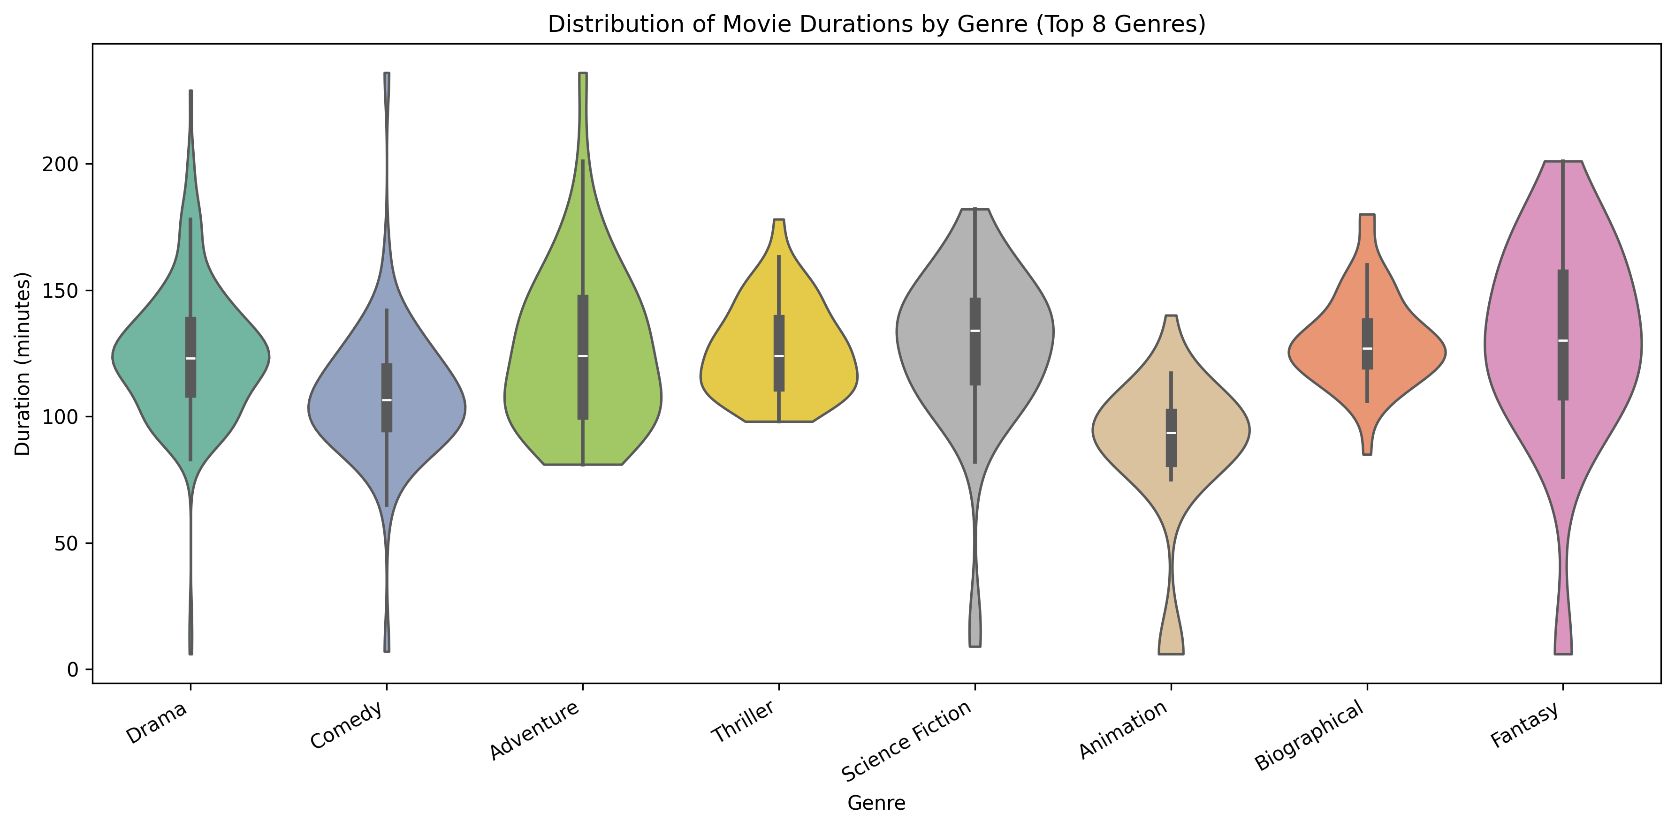
Exploring Genres in the Top 500 Movies

Slide 22
Exploring Genres in the Top 500 Movies Insights & Implications
The average duration among the most popular genres is quite consistent, with animated films tending to be slightly shorter. This may reflect the intensive production demands of animation or the genre’s appeal to younger audiences with shorter attention spans.
Drama is by far the most prevalent genre in the top 500, standing out well ahead of others.
The most frequent genre combinations almost always include Drama—such as the leading pair Drama + War—though Action + Sci-Fi also features prominently, ranking third among combinations.

Slide 23

Thank You!
Thank you for your time and attention! I appreciate your interest in my project.
Contact: gbortnik10@gmail.com
GitHub Profile: GBortnik
Project repository is available HERE.

